Slide 1

Exploring Trends and Seasonality in Time Series data
Ashwini Sharma

Slide 2

Content
Motivation
Challenges
Time Series Analysis - Concepts
Technical Details
Experimental Results
TSA Libraries used in Industry
Conclusion

Slide 3

Motivation
Time series datasets are set of data points, sequenced over time, and the order in which samples are processed is of vital importance.
Time series data contains trend, seasonal and cyclic components which makes it challenging to capture, train and predict effectively.
Linear Regression models assume the relation between variables to be constant over the time. Time series data may exhibit non-stationarity.
Time series data has many use cases like sales and weather forecasting, change in inflation rate, country-wide GDP, job growth, and financial analysis, which makes it critical for decision-making.

Slide 4
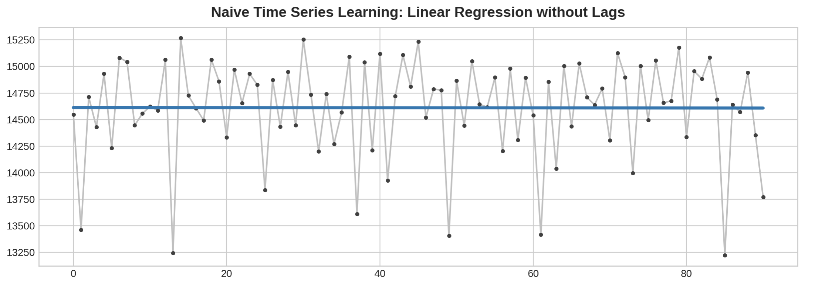
Naïve Learning Problem

Slide 5

Challenges
Finding the dataset with enough observations as well as seasonality component along with trends to train the model.
Checking the stationarity in the time series data. Once found, ways to make the data stationary.
Which statistical model is better to handle the trends as well as seasonality in the data.
Is hyperparameter tuning required?

Slide 6
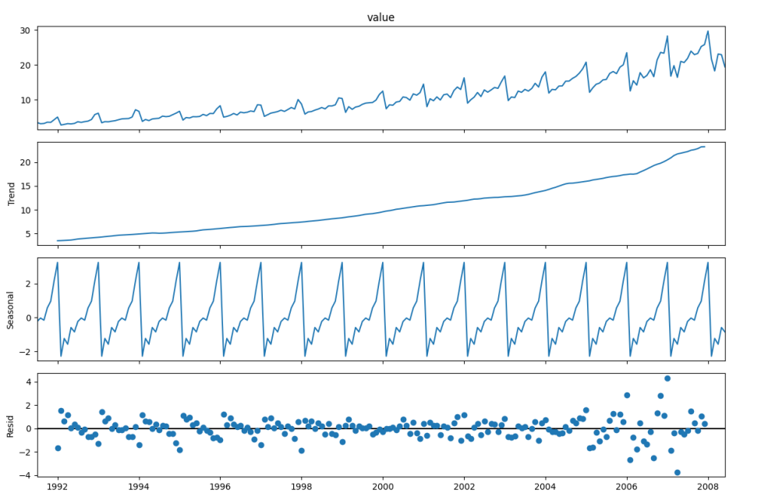
Time Series Analysis Concepts: What
Time Series has four components which are described below:
Trend: There is no fixed time interval. It represents growth or decline in the data over an extended period.
Cycle: It represents repeated patterns or fluctuations in the data.
Seasonality: It represents the pattern repeated at regular intervals.
Irregularity: It captures the unpredictable elements in the time series.

Slide 7
Time Series Analysis Concepts: Why
It is important to check as most statistical models support only stationary datasets.
If a dataset doesn't have Trend, Seasonality, Cyclical, and Irregularity components of the time series, then it's Stationary.
Constant mean value; constant variance with time-frame & If either the mean-variance or covariance (relationship between two variables) is changing with respect to time, the dataset is called non-stationary.

Slide 8
Time Series Analysis Concepts: How to Check
Different methods were used to test the hypothesis:
KPSS(Kwiatkowski-Phillips-Schmidt-Shin): A statistical test to check the stationarity in time series data for checking the trend in the data. The KPSS test is conducted with the following assumptions.
Null Hypothesis (HO): Series is trend stationary or series has no unit root.
Alternate Hypothesis(HA): Series is non-stationary, or series has a unit root.
ADF(Augmented Dickey-Fuller) : It is also a statistical test to check the stationarity of the time series data by checking unit root. ADF test is conducted with the following assumptions:
Null Hypothesis (HO): Series is non-stationary, or series has a unit root.
Alternate Hypothesis(HA): Series is stationary, or series has no unit root.
Note: The hypothesis is reversed in the KPSS test compared to ADF Test.
A unit root is a characteristic of a time series variable that indicates it has a stochastic or random trend. In simpler terms, a variable with a unit root is unpredictable and does not revert to a stable mean over time.

Slide 9
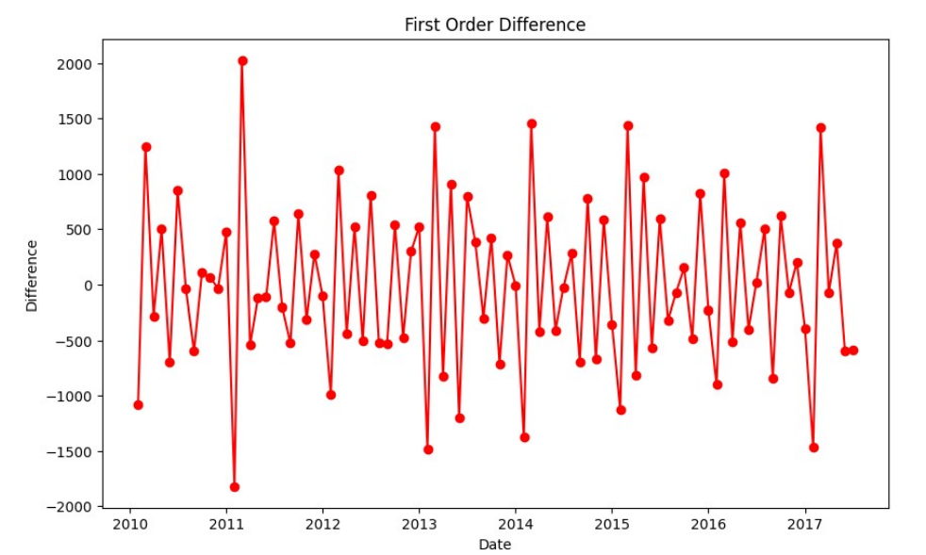
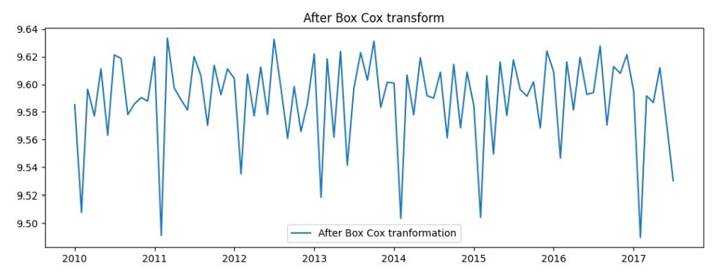
Time Series Analysis Concepts: How to Transform
To use models for predictions, we should do the below things:
• Differencing: Transform the data by computing difference between consecutive observations (can be repeated, d-orders)
• Transformation (log, BoxCox): It is common preprocessing step in time series analysis to transform non-stationary data into stationarity data (stabilize variance).

Slide 10
Technical Details: Statistical Model
AR(Auto-Regressive): It will be addressing autocorrelation by taking into the account the relationship between observation and lagged observations.
MA(Moving Average): It will be performed by taking out fluctuations and focusing on trend over a specific period. It is calculated by taking average of all data points in given period.
ARMA(Auto-Regressive Moving Average) : It is useful when a time series exhibits both autoregressive and moving average behavior. It involves using statistical methods to fit the model to the observed time series data. This can be done using techniques such as maximum likelihood estimation.
ARIMA(Auto-Regressive Integrated Moving Average): Used to forecast the future value of univariate time series data.
SARIMA(Seasonal Auto-Regressive Integrated Moving Average): To capture both seasonal and non-seasonal components in data using period parameter.

Slide 11
Experimental results: With Random Values
Model | RMSE | MAE
AR | 692.151 | 534.061
MA | 740.450 | 597.118
ARMA | 743.016 | 648.108
ARIMA | 741.809 | 599.068
SARIMA | 431.838 | 333.449
Notes:
Global sales dataset for 8 years ranging from 2010 – 2017; aggregated monthly; total points 91, train 79 and test 12

Slide 12
Experimental results: Hyperparameter Tuning using auto_arima from pmdarima library
ARIMA | Before Tuning | After Tuning
RMSE | 741.809 | 692.151
MAE | 599.068 | 534.061
SARIMA | Before Tuning | After Tuning
RMSE | 431.838 | 412.061
MAE | 333.449 | 320.800

Slide 13

TSA Libraries used in Industry
TBATS (Trigonometric seasonality, Box-Cox transformation, ARMA errors, Trend, and Seasonal components): It is a time series forecasting method which deals with multiple seasonality and complex patterns.
We give raw data and visual inspection; stationarity testing and transformation is not required, and we get this output.
Model Summary:
Use Box-Cox: True , Use trend: False , Use damped trend: False ,Seasonal periods: [12.],
Seasonal harmonics [5] , ARMA errors (p, q): (1, 1) , Box-Cox Lambda 1.000000 , Smoothing (Alpha): 0.010317
FB Prophet: It is an open-source tool which is developed by Facebook for forecasting the time series data. It is designed to handle daily observations. Predict future points using raw data with confidence interval

Slide 14
Conclusion
After running both ARIMA and SARIMA using the best hyperparameters (from tuning) we can conclude that SARIMA produced better results as seasonal component is present in our dataset (annual frequency).
The results from evaluation metrics, RMSE and MAE both produce a lower error for SARIMA, mentioned below:
ARIMA
RMSE: 692.151
MAE: 534.061
SARIMA
RMSE: 412.061
MAE: 320.800

